Slide 1



Spreadsheet
Class VI
lab 22

Slide 2
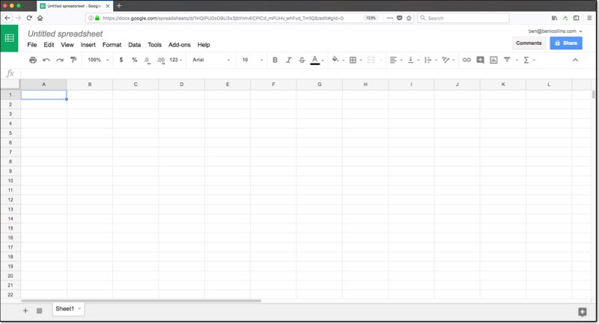
Editing Window
This is what your blank Google Sheets will look like

Slide 3
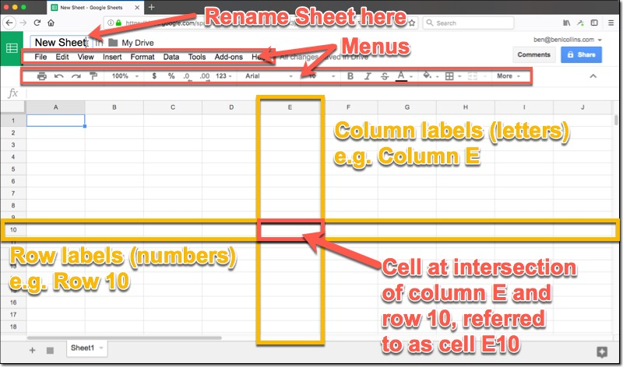
Window Overview

Slide 4
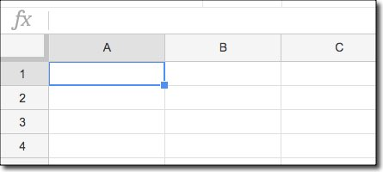
Fundamental Concepts
Click cell A1 (that’s the intersection of column A with row 1, the cell in the top left corner of the Sheet) and you’ll see a blue box around the cell, to indicate it’s highlighted

Slide 5
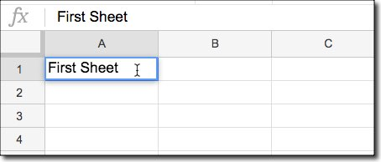
Fundamental Concepts
simply start typing and you’ll see the data being entered into that cell

Slide 6
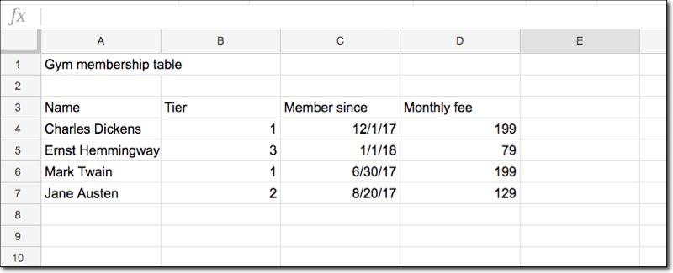
Creating a Basic Table
Enter data in correct celll to
for making a table

Slide 7



